Slide 1
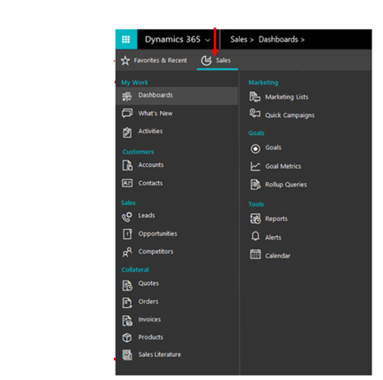
Work area
Access favorite and recently viewed records
List of records in the selected work area

